Slide 1
Food Ordering Management System

Slide 2
Introduction
Ultimate goal is the management of:
Suppliers
Products
Users
Orders
Customers, and
Payments
Employees
Web based technology – PHP

Slide 3
Food Ordering Management System – FOMS
Fully integrated, web-based application
Enhances data integrity and access
Full-district deployment
Current, standards-based technology
Data Warehouse for data consolidation

Slide 4
FOMS
Products
Orders
users
Databases
Web technology
Management
Core
Services
Employees
Infrastructure
Suppliers
Customers

Slide 5
The Architecture of the Solution
Products
Orders
Employees
Suppliers
Users
Customers
Food Ordering Management System
Database Server
Web Server
Application Server
SQL
Apache
Web Objects

Slide 6
Database Server
Database Server
SQL

Slide 7
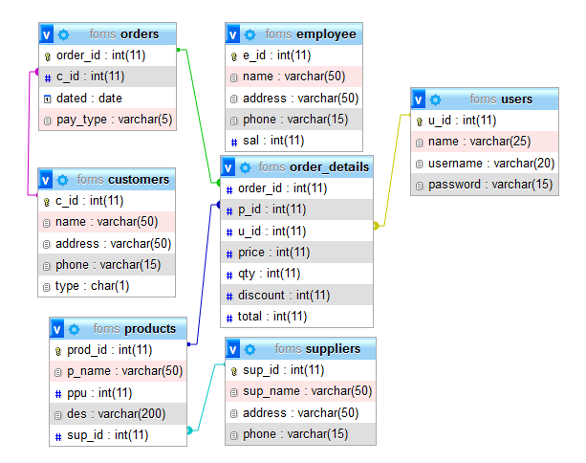
Entity Relationship Diagram

Slide 8
DDL – Table Creation example
CREATE TABLE `order_details` ( `order_id` int(11) NOT NULL, `p_id` int(11) NOT NULL, `u_id` int(11) NOT NULL, `price` int(11) NOT NULL, `qty` int(11) NOT NULL, `discount` int(11) NOT NULL, `total` int(11) NOT NULL) ENGINE=InnoDB DEFAULT CHARSET=utf8mb4;
CREATE TABLE `products` ( `prod_id` int(11) NOT NULL, `name` varchar(50) NOT NULL, `ppu` int(11) NOT NULL, `des` varchar(200) DEFAULT NULL, `sup_id` int(11) NOT NULL) ENGINE=InnoDB DEFAULT CHARSET=utf8mb4;

Slide 9
DDL – Constraints and indexes
Primary key constraints
ALTER TABLE `products` ADD PRIMARY KEY (`prod_id`), ADD KEY `FK_sup_id1` (`sup_id`);
Foreign key constraints
ALTER TABLE `order_details` ADD CONSTRAINT `FK_order_id2` FOREIGN KEY (`order_id`) REFERENCES `orders` (`order_id`), ADD CONSTRAINT `FK_p_id2` FOREIGN KEY (`p_id`) REFERENCES `products` (`prod_id`), ADD CONSTRAINT `FK_u_id` FOREIGN KEY (`u_id`) REFERENCES `users` (`u_id`);
Indexes
ALTER TABLE `employee` ADD KEY `name` (`name`);

Slide 10
Data dump into SQL Table – example
INSERT INTO `customers` (`c_id`, `name`, `address`, `phone`, `type`) VALUES(1, 'Kaveat', 'Libya', '838 882 883', 'D'),(2, 'Beccar', 'Bosnia', '283 882 773', 'W'),(3, 'Cesar', 'Syria', '253 823 123', 'W'),(4, 'Gullich', 'Indiana', '929 300 3882', 'W'),(5, 'Ficher', 'Alaska', '122 333 223', 'W'),(6, 'Loclu', 'Netherlands', '333 452 332', 'W'),(7, 'Voiley Brey', 'Georgia', '8877 44 2232', 'D');
INSERT INTO `order_details` (`order_id`, `p_id`, `u_id`, `price`, `qty`, `discount`, `total`) VALUES(1, 4, 5, 150, 100, 200, 14800),(2, 3, 5, 85, 40, 70, 3330),(6, 2, 6, 100, 4, 10, 390),(3, 4, 1, 150, 30, 0, 450),(4, 6, 7, 120, 3, 4, 356),(5, 1, 1, 130, 100, 400, 12600),(7, 1, 1, 120, 5, 50, 550);

Slide 11
DML – Complex queries
SELECT od.order_id, od.price, od.qty, od.discount, od.total, c.name, p.p_name, o.dated, o.pay_type, u.username
FROM order_details od
INNER JOIN orders o
ON od.order_id=o.order_id
INNER JOIN customers c
ON o.c_id=c.c_id
INNER JOIN products p
ON od.p_id=p.prod_id
INNER JOIN users u
ON od.u_id=u.u_id
WHERE p.p_name LIKE '%$query%';

Slide 12
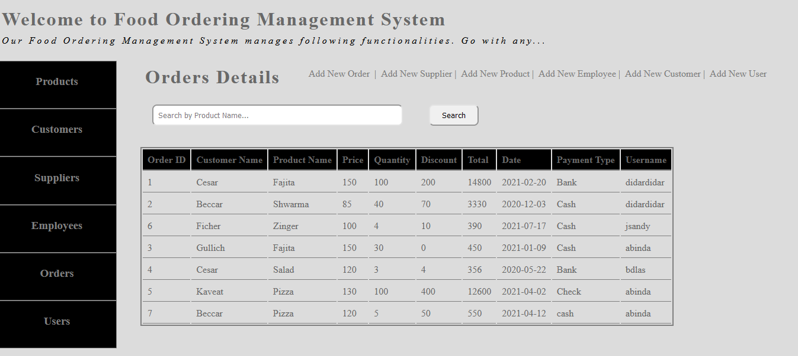
Web-based solution – index.php

Slide 13
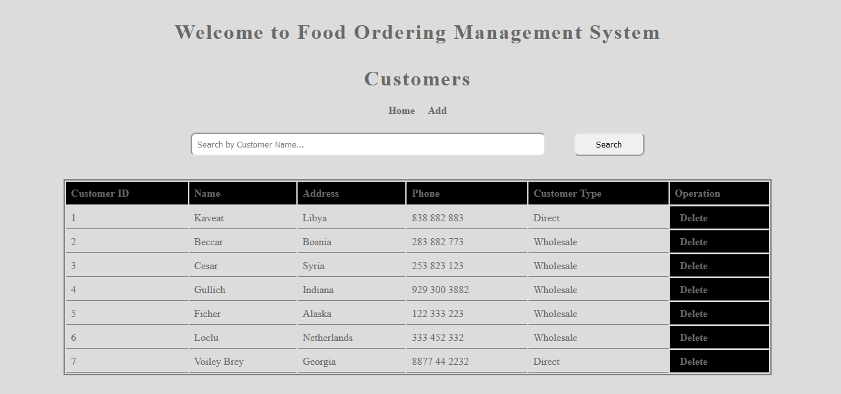
Data visualization in web – example with removal option

Slide 14
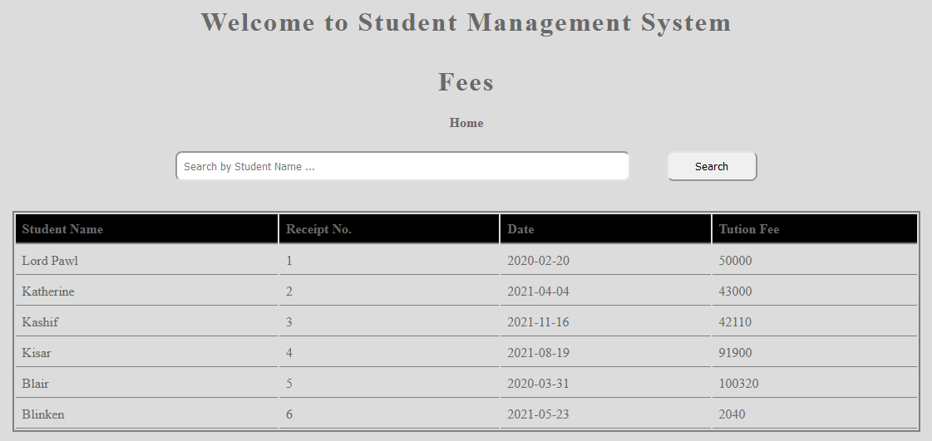
Data visualization in web – example2

Slide 15
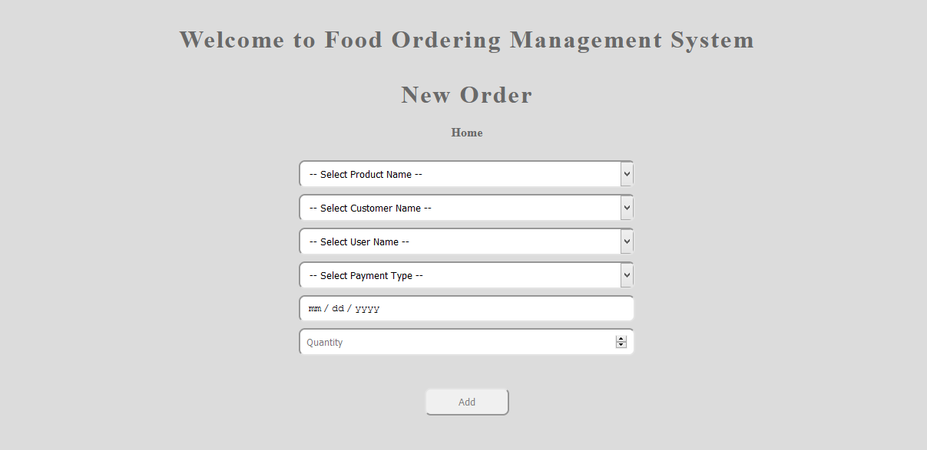
Adding New data via web

Slide 16
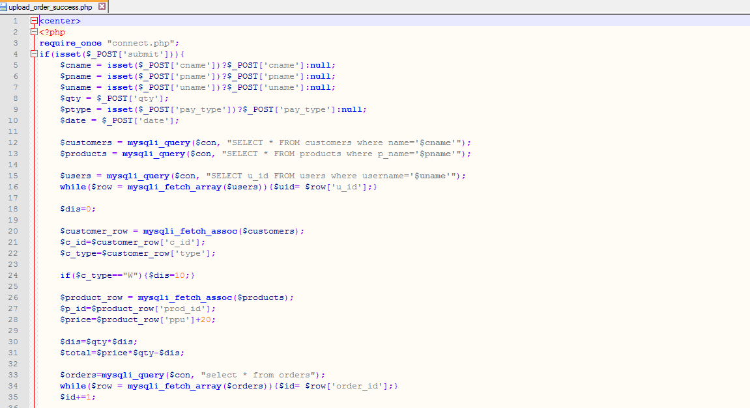
PHP coding – example

Slide 17
The challenges
Legacy to Web-based
Updated architecture — Web servers, PHP
Need to re-tool local talent
Changes in functionality from character-based to browser-based
Universal access

Slide 18
The end!

